Slide 1

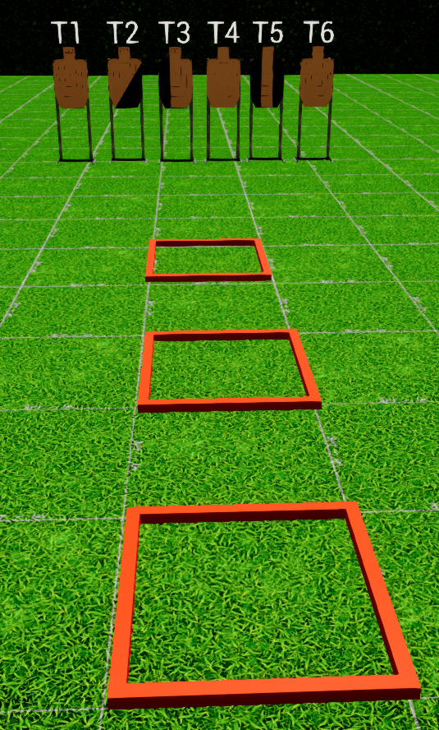
 | Interlake Sporting Association North Pistol, B Stage: North Pistol, B – One Shot One Kill Course Designer: Peter Jarvis
SCENARIO: Standards
START POSITION:Standing in P1, wrists below belt. Handgun: Loaded and holstered PCC: Stock on belt, muzzle pointed downrange |  | STRINGS: 1 SCORING: Unlimited/Limited SCORED HITS: Best 2 ROUND COUNT: X TARGETS: 5 IDPA, 1 NT, 1 PP START-STOP: Audible - Last shot CONCEALMENT: Required Muzzle Safe Points: Muzzle safe markers / 180 degree rule SO NOTES:
STAGE PROCEDURE: At the start signal, engage NOTES:
P3
P2
P1

